Slide 1

DESIGN STUDIO U21EE307
PROJECT TITLE – JUST FOOD
Batch number :01
Presented by : JAI AAKASH SD (22ee017)
Name (in CAPS) | Roll number (in CAPS)
RATHISH KUMAR M | 22ee042
PRAVEEN KUMAR K | 22ee038
GIRI PRASATH B P | 22ee013
SOUNDER KUMAR S | 22ee050
1

Slide 2
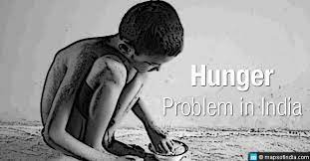
PROBLEM STATEMENT/ ABSTRACT/ SDG
Nearly one in ten people around the world go to bed hungry each night, a crisis driven largely by conflict, climate change, and chronic inequality.
Children Die Each Day from Illnesses Caused by Dirty Water and Unhygienic Living Conditions.
1

Slide 3
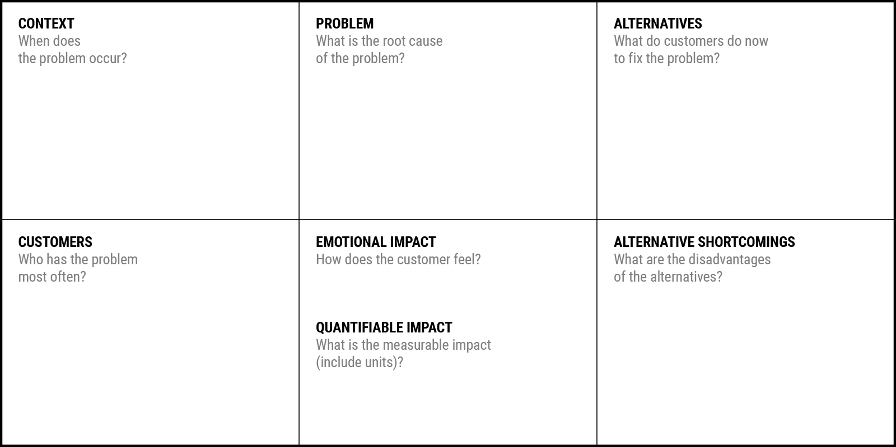
Problem Statement Canvas
Which is your Customer Segment:
Your Answer:
Your Answer:
Your Answer:
Your Answer:
Your Answer:
Your Answer:
Your Answer:

Slide 4
Idea/Solution/Prototype (Describe)
1

Slide 5
Process flow chart or simulated image of prototype
1

Slide 6
Technology stack
1

Slide 7
USER CASES
1

Slide 8
Dependencies / Show stopper
1

Slide 9



